Slide 1
F5的安全解决方案 多层级DDoS防护和防欺诈
Security Solution Architect
Andy Jin

Slide 2

HP首席信息安全顾问
中央电视台特约信息安全顾问
环球时报特约信息安全顾问
哈尔滨工业大学信息安全研究方向
项目经验：
2006年发现新浪邮箱致命漏洞；
2007年破获国防大学金一南教授泄密案；
2008年北京奥运会网络安保；
2009年破获国内首例网络电话诈骗案；
工商银行、农业银行、中国银行、建设银行、交通银行、中信银行、华侨银行、浦发银行、华夏银行、兴业银行、中国人寿、中国人保、太平洋保险、中国电信、中国移动、铁道部、中石油、中石化、国航、首钢、国家电网、南方电网、一汽大众、上海大众、中国商用飞机有限公司等信息安全项目。
媒体采访：
09年1月接受《东方时空》栏目针对网络电话诈骗案的采访；
09年1月接受《焦点访谈》栏目针对网络电话诈骗案的采访；
09年12月接受《东方时空》针对519断网案的采访；
10年1月接受《东方时空》栏目针对政府网站被篡改事件的采访；
10年12月接受环球时报英文版针对《Calls to curb Internet hacking 》的采访。
11年1月接受环球时报英文版针对《Hacked iTunes accounts sold online》的采访；
11年2月接受环球时报英文版针对《Spyware found in 150000 mobile phones》的采访；
12年3月31日接受《24小时》针对匿名者阻断互联网事件的现场嘉宾采访；
13年9月24日接受《焦点访谈》针对清烟器网络信息的采访；
13年11月3日接受《焦点访谈》针对手机二次打包软件包含恶意软件的采访。

Slide 3
Multi Layer DDoS Protection Architect

Slide 4
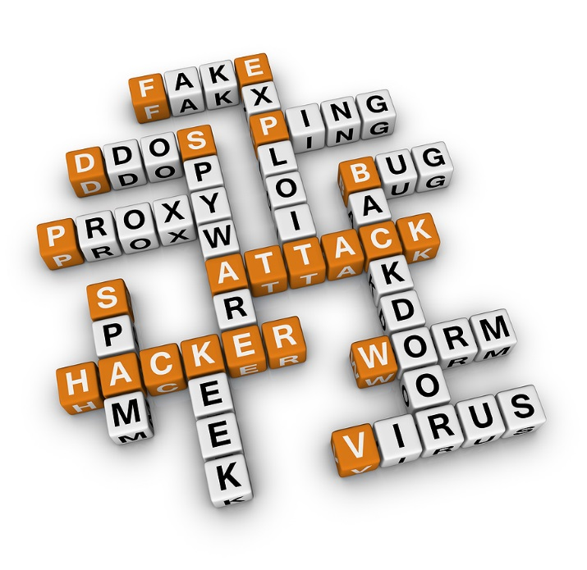


It’s time to rethink security
是时候重新思考安全
对手已经采用整合攻击平台
可以高频的变化打击方法和目标
传统防护体系在对抗中没有优势
应用层攻击与正常业务越来越难区分
Notes:
AET 高级逃逸技术.应用识别技术是下一代防火墙产品的核心要素。DPI深度报文检测,DFI深度流量检测

Slide 5

The traditional approach to security is inadequate.

Slide 6
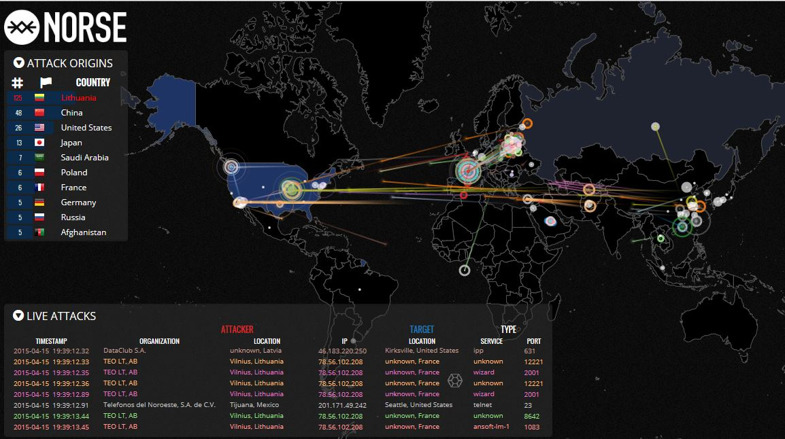

Slide 7







DDoS attacks攻击的主要种类
网络层DDoS攻击
应用层DDoS攻击
M61 Vulcan
SVD
Notes:
M61
口径 20mm
初速1045m/s
射速4000～4400rds/min(带M7传动装置）
6000～7200rds/min(带M12传动装置)
射程 3000m
SVD
产地：前苏联
口径：7.62 mm
弹药：7.62x54mmR步枪弹
弹匣容量：10发
自动方式：导气式
闭锁方式：枪机回转闭锁
全长：1220 mm
枪管长：620 mm
弹头初速：828 m/s
瞄准镜：PSO-1型
机械瞄具：1200 m
瞄具射程 光学瞄准镜：1300 m
夜视瞄准镜：300 m
有效射程 800m
最大杀伤射程：1300 m
枪口动能：3302 Joule
不含瞄准镜和空弹夹重：3.7 kg
含瞄准镜和空弹夹重：4.3 kg
含瞄准镜全宽：88 mm
含瞄准镜全高：230 mm

Slide 8
Botnet Business MODELS
DDoS
$50-$1500 (1 Day)
Botnet
SPAM Sending
$150-$200 (1M Emails)
Creating Botnet
Adversary & Malware Loader
$0.3-$1.5 (1 Installation)
Exploit Packs Sell
$1-$1500 (1 Bank Account)
USA: $5-$8
Europe: 3 * USA
Confidential Info Stealer
Traffic Sell
Phishing
$1000-$2000 (1 Month)
Antivirus Evasion Service
Comment Spam
$300 (1 Month)

Slide 9
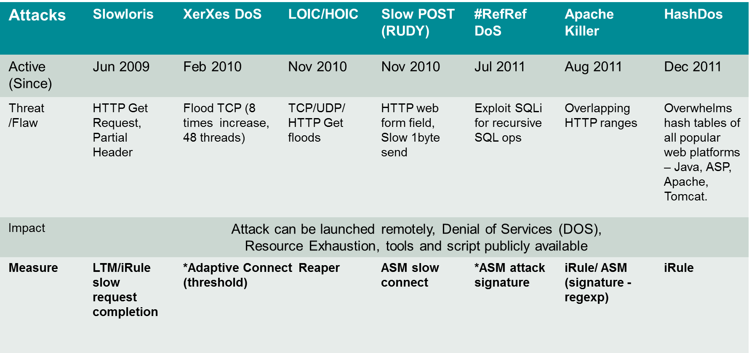
应用层DDoS工具发展进程及F5应对措施

Slide 10
OSI 层级 | 攻击内容 | LTM AFM | LTM+ iRule | IP Intel | DNS | ASM
Network Based (2-4层) | IP Fragment
 | Tear Drop
 | SYN Flood (Dirt Jumper)
 | TCP (connection) Flood e.g. SYN-ACK, ACK & PUSH-ACK, RST or FIN and Fragmented ACK
 | Christmas Tree
 | Fake Session
 | LAND
 | Redirect Traffic Attack
 | ICMP Flood, Ping Floods and SMURF Attacks
 | Ping of Death ICMP
DNS based (4层) | UDP Flood
 | UDP Fragment
 | DNS Flood (Distributed and DNS Blacklisting) e.g. DNS UDP Flood, DNS Query Flood and DNS NXDOMAIN Flood |  | IP Blacklist (Datagrp) |  | DNS Express + DNS iRule
SSL/TLS based (5–6层) | SSL Floods, Malformed SSL (e.g. empty SSL HELLO)
 | SSL THC attack (Extending from SSL Renegotiation vulnerability) |  |  | IPintel iRule
Application based (6–7层) | Slowloris (Nuclear DDoSer, Slowhttptest)
 | Keep-Dead
 | Slow POST (R-U-Dead-Yet, Tor Hammer, Nuclear DDoSer, Slowhttptest)
 | HashDoS
 | Apache Killer (Slowhttptest)
 | HTTP GET Flood, Recursive GET Flood (Web Scraping), Dirt Jumper (HTTP Flood) |  |  | IP intel iRule
 | #RefRef (exploit SQLi - OWASP Top 10 vulnerability as entry)
 | XML “Bomb” (DTD attack), XML External Entity DoS
对应关系矩阵

Slide 11
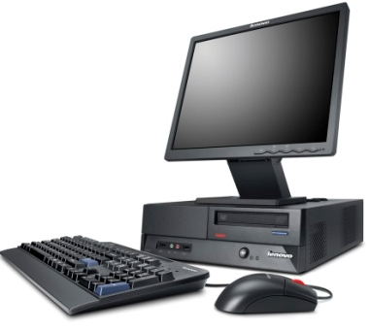
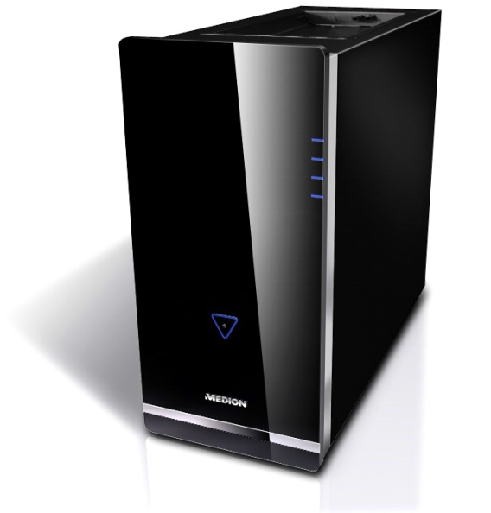
基于应用的DDoS攻击-- Slowloris
………….. 299 seconds
1
350
2
200
10
50
并发连接数 connections
20
Partial HTTP request
Partial HTTP request
Time out value?
攻击者Attacker
300 seconds
FULL
受害者 Victim
Idle timeout: 300 seconds
394 open connections
保持的链接数

Slide 12
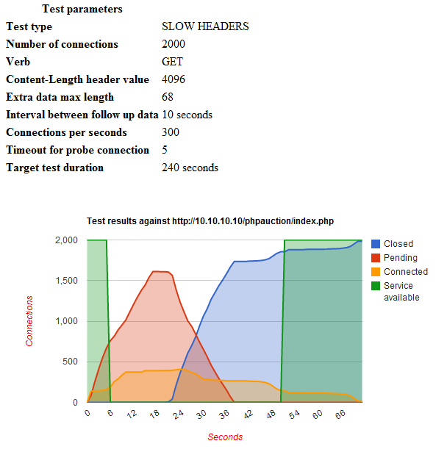
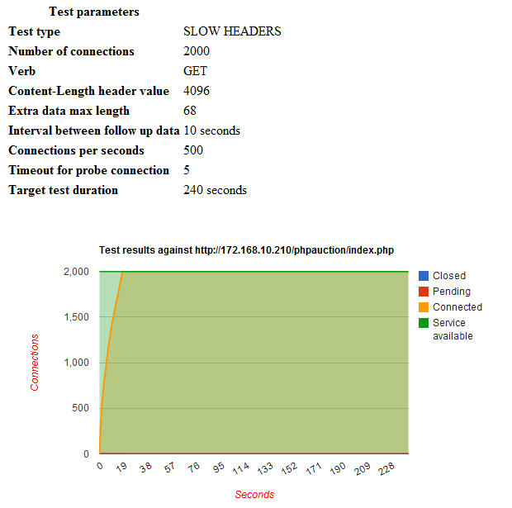


Slowloris 攻击测试 (单一攻击者实例)
Without F5
With
F5 (LTM)

Slide 13


Layer7 DDoS Attack – Slow Post
1
350
2
200
10
50
Concurrent connections
20
Bytes expected:
99999
Expecting 99999 bytes
1
Bytes received:
2
Attacker
HTTP POST Content-Length: 99999
FULL
HTTP POST Content-Length: 99999
Victim
Idle timeout: 300 seconds

Slide 14
Layer7 DDoS Attack – SSL Renegotiation
1X
SSL
SSL
SSL
15X
SSL
SSL
SSL
SSL connection
SSL
Attacker
CRASH
Victim HTTPS Web server
Any HTTPS server is vulnerable

Slide 15

全代理安全架构 Full proxy security
WAF
WAF
Slowloris attack
HTTP
iRule
iRule
HTTP
Data leakage
XSS
SSL renegotiation
SSL
iRule
iRule
SSL
SYN flood
TCP
iRule
iRule
TCP
ICMP flood
Network Firewall

Slide 16


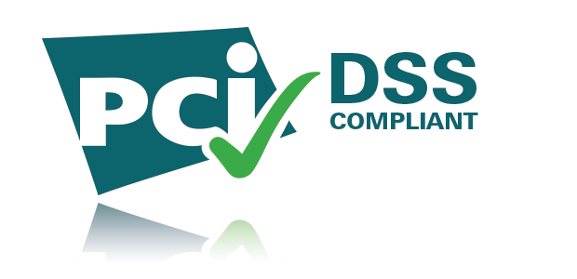

F5 Silverline SOC and Scrubbing Centres
24/7 Support
Global Coverage
Industry-Leading Bandwidth
F5 Security Operations Center (SOC) is available 24/7 with security experts ready to respond to DDoS attacks within minutes
Seattle, WA US
Fully redundant and globally distributed data centers world wide in each geographic region
San Jose, CA US
Ashburn, VA US
Frankfurt, DE
Singapore, SG
Attack mitigation bandwidth capacity over 2.0 Tbps
Scrubbing capacity of over 1.0 Tbps
Guaranteed bandwidth with Tier 1 carriers
Notes:
Tier 1 Bandwidth is not shared or based on peering arrangements
Diversely located for minimal latency injection
High density edge routing
Anycast network deployment

Slide 17
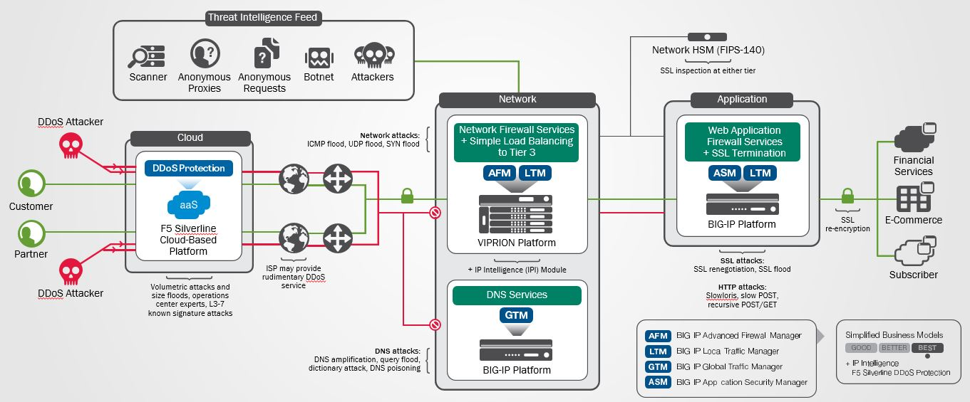

Slide 18
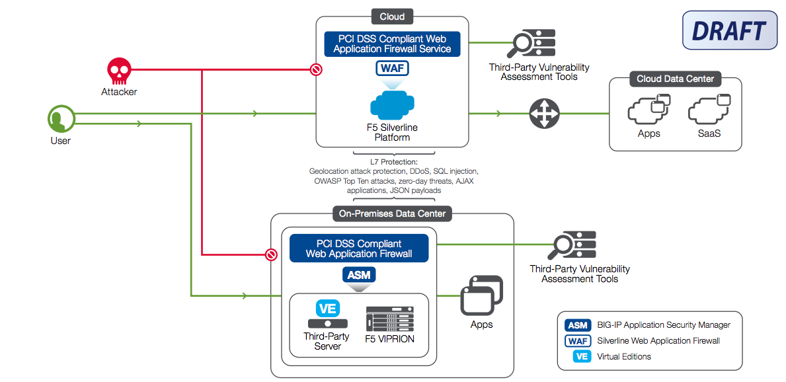

Slide 19
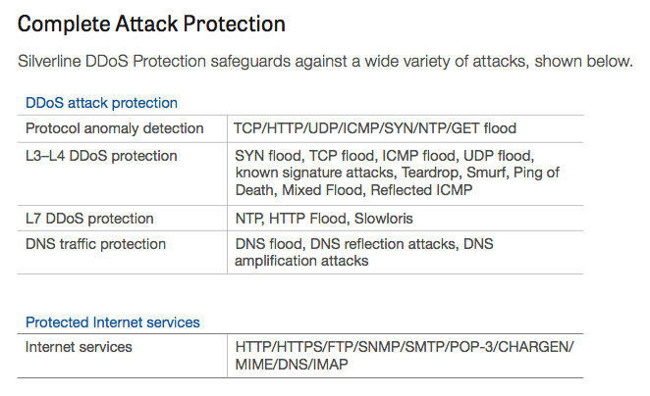
List of DDoSaaS Protections

Slide 20
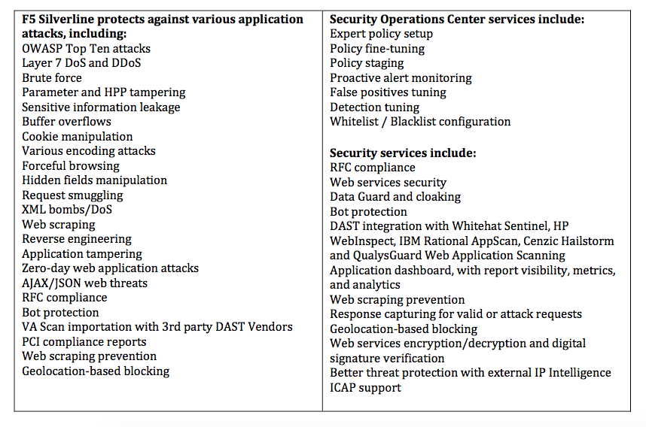
List of WAFaaS Protection

Slide 21
More sophisticated attacks are multi-Layer
Network
Notes:
Network
Good old fill pipe and attacks that kill statefull devices
DNS
Could still be fill pipe on the receiving end of reflection attacks
Could be attack your DNS infrastructure
DNS cache poisoning
SSL
Its an SSL world, new protocols like SPDY
Not just the fact that the traffic be encrypted
Protocol itself SSL renegotiation
Application
This could really be a range of anything from the OWASP top 10
A1 Injection
A2 Broken Authentication and Session Management
A3 Cross-Site Scripting (XSS)
A4 Insecure Direct Object References
A5 Security Misconfiguration
A6 Sensitive Data Exposure
A7 Missing Function Level Access Control
A8 Cross-Site Request Forgery (CSRF)
A9 Using Components with Known Vulnerabilities
A10 Unvalidated Redirects and Forwards

Slide 22
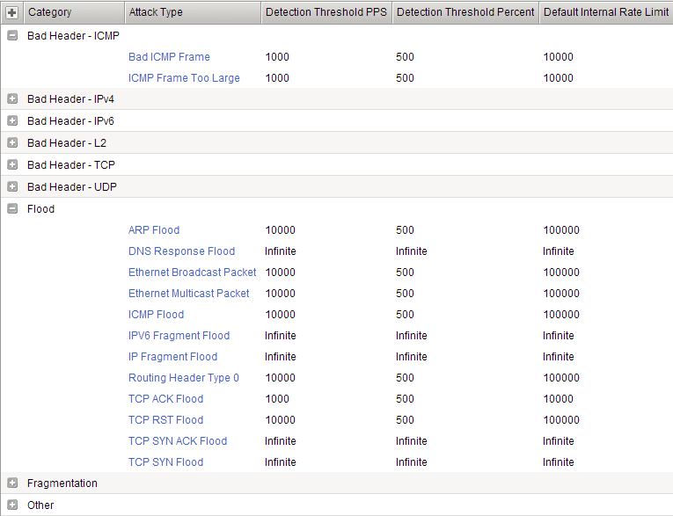
AFM: Stateless DoS detection & mitigation L2-L4 stateless dos vectors
When to report an attack
Absolute Number in PPS Detection Threshold
DOS
Vectors
When to report an attack
Relative Percent Increase in PPS Detection Threshold
When to mitigate an attack
Absolute Number in PPS Mitigation Threshold
DOS Categories

Slide 23
More sophisticated attacks are multi-Layer
DNS
Network
Notes:
Network
Good old fill pipe and attacks that kill statefull devices
DNS
Could still be fill pipe on the receiving end of reflection attacks
Could be attack your DNS infrastructure
DNS cache poisoning
SSL
Its an SSL world, new protocols like SPDY
Not just the fact that the traffic be encrypted
Protocol itself SSL renegotiation
Application
This could really be a range of anything from the OWASP top 10
A1 Injection
A2 Broken Authentication and Session Management
A3 Cross-Site Scripting (XSS)
A4 Insecure Direct Object References
A5 Security Misconfiguration
A6 Sensitive Data Exposure
A7 Missing Function Level Access Control
A8 Cross-Site Request Forgery (CSRF)
A9 Using Components with Known Vulnerabilities
A10 Unvalidated Redirects and Forwards

Slide 24
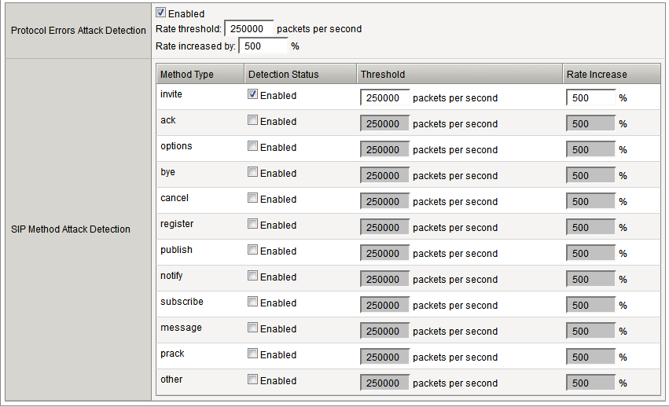
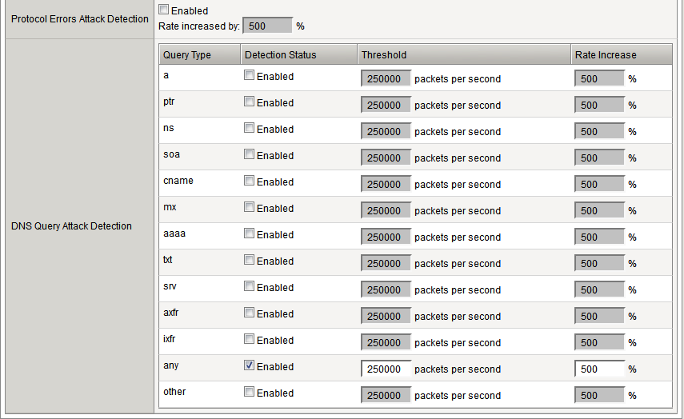
AFM: Stateless App. Layer DoS Detection Application protocol volumetric attack detection: DNS & SIP
Malformed/Protocol Violations Detection
DNS DOS Detection by Query Type
When to report and attack. Absolute and Relative Increase Detection Thresholds
SIP DOS Detection by Method
When to report and attack
Absolute and Relative Increase Detection Thresholds

Slide 25
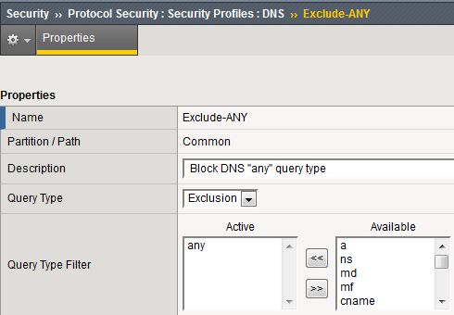
AFM: Protocol Security – DNS Application Protocol compliance & DoS mitigation : DNS
Filter by DNS Query types
a | m | mg | loc | ixfr | dname | nsec3param
aaaa | px | rp | spf | cert | nesc3 | ipseckey
any | md | mr | eid | apl | dhcid | nsap_ptr
cname | mf | null | nxt | axfr | zxfer | nsap
mx | a6 | wks | key | sink | rrsig | nimloc
ns | rt | dlv | x25 | naptr | sshfp | dnskey
ptr | mb | hip | sig | isdn | maila | mailb
soa | ds | opt | tsig | nsec | afsdb | hinfo
srv | kx | txt | ata | gpos | tkey | minfo

Slide 26
More sophisticated attacks are multi-Layer
SSL
DNS
Network
Notes:
Network
Good old fill pipe and attacks that kill statefull devices
DNS
Could still be fill pipe on the receiving end of reflection attacks
Could be attack your DNS infrastructure
DNS cache poisoning
SSL
Its an SSL world, new protocols like SPDY
Not just the fact that the traffic be encrypted
Protocol itself SSL renegotiation
Application
This could really be a range of anything from the OWASP top 10
A1 Injection
A2 Broken Authentication and Session Management
A3 Cross-Site Scripting (XSS)
A4 Insecure Direct Object References
A5 Security Misconfiguration
A6 Sensitive Data Exposure
A7 Missing Function Level Access Control
A8 Cross-Site Request Forgery (CSRF)
A9 Using Components with Known Vulnerabilities
A10 Unvalidated Redirects and Forwards

Slide 27
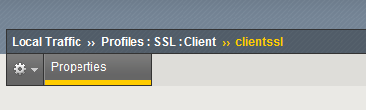
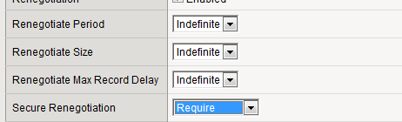
SSL Renegotiation Mitigation

Slide 28
More sophisticated attacks are multi-layer
Application
SSL
DNS
Network
Notes:
Network
Good old fill pipe and attacks that kill statefull devices
DNS
Could still be fill pipe on the receiving end of reflection attacks
Could be attack your DNS infrastructure
DNS cache poisoning
SSL
Its an SSL world, new protocols like SPDY
Not just the fact that the traffic be encrypted
Protocol itself SSL renegotiation
Application
This could really be a range of anything from the OWASP top 10
A1 Injection
A2 Broken Authentication and Session Management
A3 Cross-Site Scripting (XSS)
A4 Insecure Direct Object References
A5 Security Misconfiguration
A6 Sensitive Data Exposure
A7 Missing Function Level Access Control
A8 Cross-Site Request Forgery (CSRF)
A9 Using Components with Known Vulnerabilities
A10 Unvalidated Redirects and Forwards

Slide 29
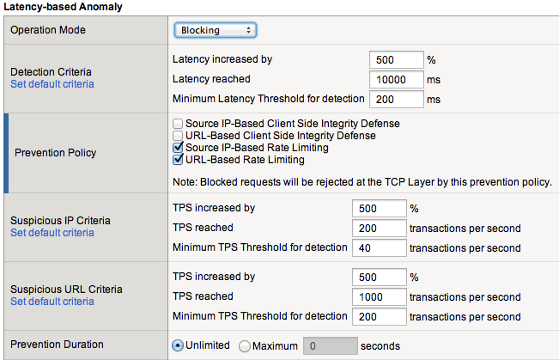
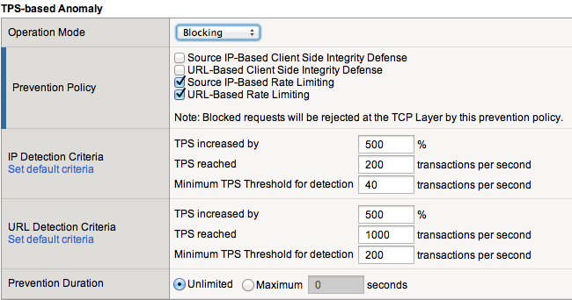
ASM: L7 DDoS Mitigation
Transaction Per Seconds (TPS) based anomaly detection
TPS-based anomaly detection allows you to detect and mitigate DoS attacks based on the client side.
Latency based anomaly detection
Latency-based anomaly detection allows you to detect and mitigate attacks based on the behavior of the server side.

Slide 30
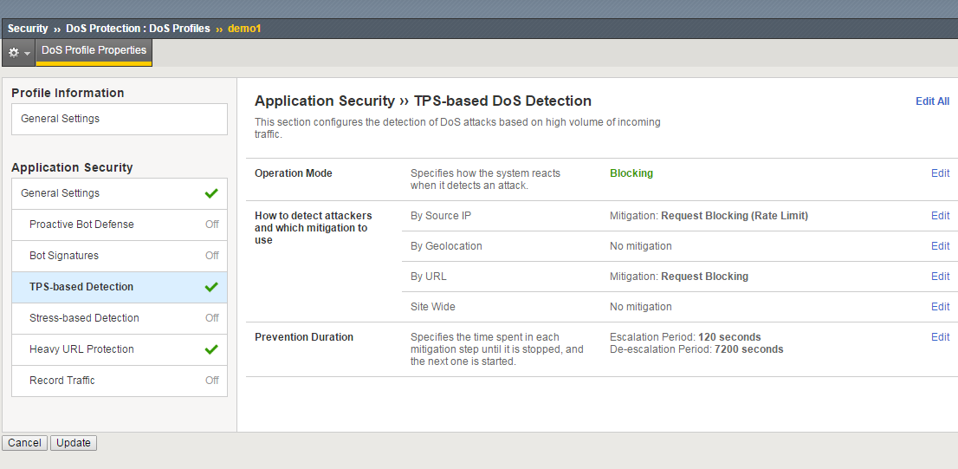
HTTP Floods – Detection and Mitigation with TPS Based Detection
Notes:
The first detection method that can be used for HTTP floods is the TPS based detection which is also enabled by default.
TPS based detection includes the following options that can be used to detect HTTP floods:
IP Detection Criteria
Geolocation Detection Criteria
URL Detection Criteria
Site-Wide Detection Criteria

Slide 31
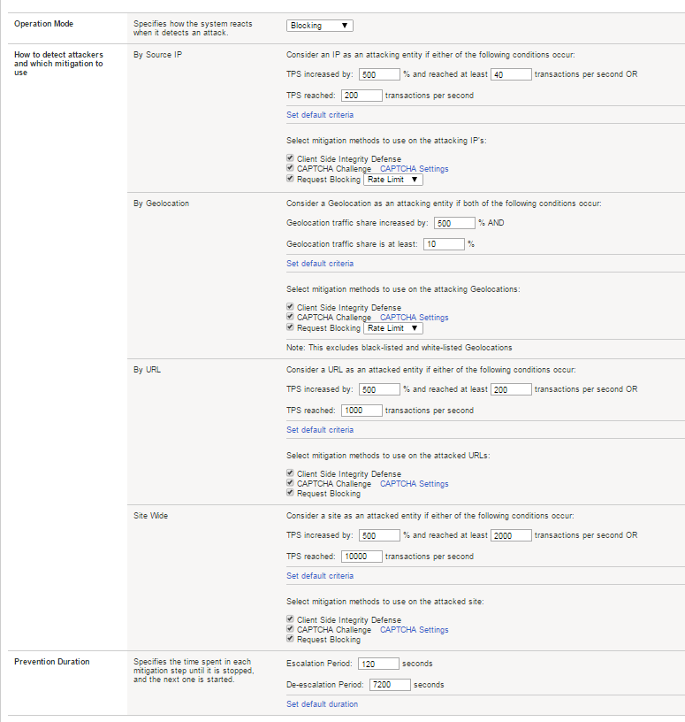
HTTP Floods – Detection and Mitigation with TPS Based Detection
1
IP Detection Criteria - Settings
Preventions polices:
Client Side Integrity Check
CAPTCHA
Request Blocking
Geolocation Detection Criteria + Preventions Polices
URL Detection Criteria + Preventions Polices
Site Wide Detection Criteria + Preventions Polices
2
2a
2b
2c
3
4
5
Notes:
Since the GUI includes various thresholds that needs to be explain we will review each one by the following order

Slide 32
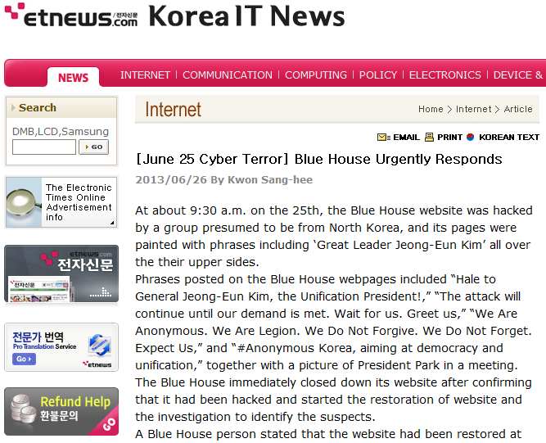
DDoS对抗案例
韩国总统府 National Intelligence Service( NIS ) Cyber Attack 2013-06-26
when HTTP_REQUEST {
set userhost [HTTP::host]
if { [HTTP::cookie exists f5korealab] } {
if { [HTTP::cookie value f5korealab] equals "mall" } {
pool Mall_Pool
} else { HTTP::redirect "http://$userhost" }
} else {
set location "[HTTP::host][HTTP::uri]"
set message1 "123"
HTTP::respond 200 content "
<html><head></head><body>
<script type=\"text/javascript\">
function sleep(ms) {
var dt = new Date();
dt.setTime(dt.getTime() + ms);
while (new Date().getTime() < dt.getTime());
}
function redirect() {
var today = new Date();
today.setDate(today.getDate() + 1);
document.cookie = \"f5korealab=mall; path=/\; expires=\" + today.toGMTString() + \"; domain=$userhost\"
window.location=\"http://$location\";

Slide 33
Web Fraud Protection Architect

Slide 34



客户浏览访问是最脆弱的环节
Customer Browser
Hmmmm…
Secured Data center
Traffic Management
Leveraging Browser application behavior
Caching content, disk cookies, history
Add-ons, Plug-ins
SIEM
WAF
NIPS
HIPS
DLP
HTTP/HTTPS
Network firewall
Manipulating user actions:
Social engineering
Weak browser settings
Malicious data theft
Inadvertent data loss
Embedding malware:
Keyloggers
Framegrabbers
Data miners
MITB / MITM
Phishers / Pharmers

Slide 35

您可能需要一个辅助的用户安全解决方案
我们是ActiveX的一种有效辅助
微软新一代浏览器Edge浏览器将不再支持ActiveX、VBScript与Brower Helper Objects(BHO)等10多项扩展及界面技术，并转向Java Script与HTML 5。
我们是Agentless的
Agentless是主流的非侵入式安全防护方式，不受硬件，终端，网络的限制。
我们不同于Anti-Virus客户端
一个在明，一个在暗，50%的恶意软件都有自动规避病毒软件的功能，只有25%的恶意软件在这个阶段被捕获
况且病毒是病毒，特洛伊是特洛伊，干大事多是特洛伊（79%的恶意软件）
我们注重于实际客户侧的安全
这不是IPS/FW/WAF能够解决的！
我们也能有效提供OTP之外的保障
一分钟之内一切均可能发生!
Notes:
Google’s Safe Browsing technology examines billions of URLs per day looking for unsafe websites. Every day, we discover thousands of new unsafe sites, many of which are legitimate websites that have been compromised. When we detect unsafe sites, we show warnings on Google Search and in web browsers.
These unsafe sites fall into two categories, both of which threaten users’ privacy and security:
Malware sites contain code to install malicious software onto users’ computers. Hackers can use this software to capture and transmit users' private or sensitive information.
Phishing sites pretend to be legitimate while trying to trick users into typing in their username and password or sharing other private information. Common examples are web pages that impersonate legitimate bank websites or online stores

Slide 36

恶意软件探测服务
Malware Detection
Notes:
Malware detection: the ability to detect malware that is running on an end-point.
Advanced phishing detection: WebSafe can detect when a hacker takes content from our customer’s web page, manipulate it as necessary to make it appear exactly like the real page, it gets uploaded to a spoofed domain, such as www.amaz0n.com, and then they attempt to lure customers to the spoofed site. WebSafe can also capture user names of victims of phishing attacks. The F5 SOC can also take down phishing domain sites.
Application layer encryption: this is a protection mechanism. It enables the customer to encrypt data on the end-point while the data is being typed into an input field. For example on a login page with username and password fields, WebSafe can have the user’s password encrypted as they type each keyboard character in real-time. This makes it impossible for malware to capture the user’s password.
Automated transaction detection: because WebSafe is JavaScript based, our solution delivers obfuscated JavaScript code to the end-point. That code then looks for things like mouse movements and clicks, keyboard impressions, and time spent filling in a form. This creates a risk level that identifies the likelihood that this was performed by malware.
When any of these components issues an alert, F5 encourages the use of our security operation center (SOC).

Slide 37
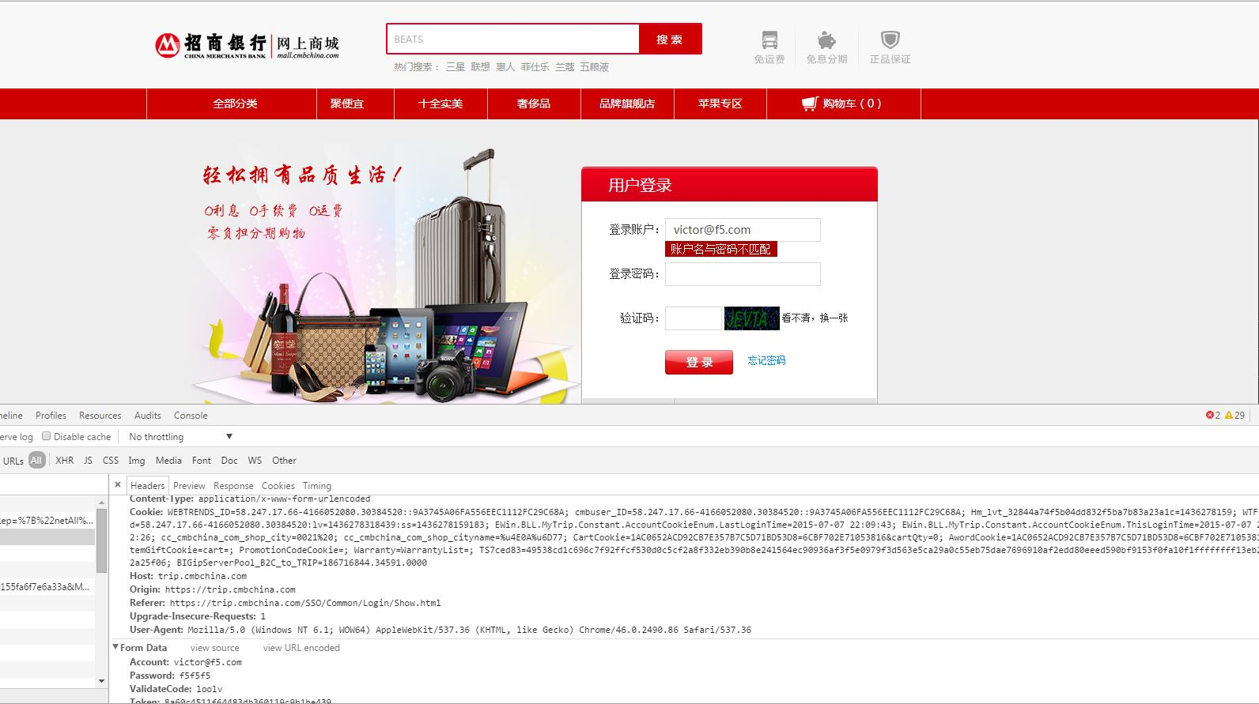
恶意软件探测服务- Generic Malware
看见密码和用户
Notes:
Malware detection: the ability to detect malware that is running on an end-point.
Advanced phishing detection: WebSafe can detect when a hacker takes content from our customer’s web page, manipulate it as necessary to make it appear exactly like the real page, it gets uploaded to a spoofed domain, such as www.amaz0n.com, and then they attempt to lure customers to the spoofed site. WebSafe can also capture user names of victims of phishing attacks. The F5 SOC can also take down phishing domain sites.
Application layer encryption: this is a protection mechanism. It enables the customer to encrypt data on the end-point while the data is being typed into an input field. For example on a login page with username and password fields, WebSafe can have the user’s password encrypted as they type each keyboard character in real-time. This makes it impossible for malware to capture the user’s password.
Automated transaction detection: because WebSafe is JavaScript based, our solution delivers obfuscated JavaScript code to the end-point. That code then looks for things like mouse movements and clicks, keyboard impressions, and time spent filling in a form. This creates a risk level that identifies the likelihood that this was performed by malware.
When any of these components issues an alert, F5 encourages the use of our security operation center (SOC).

Slide 38
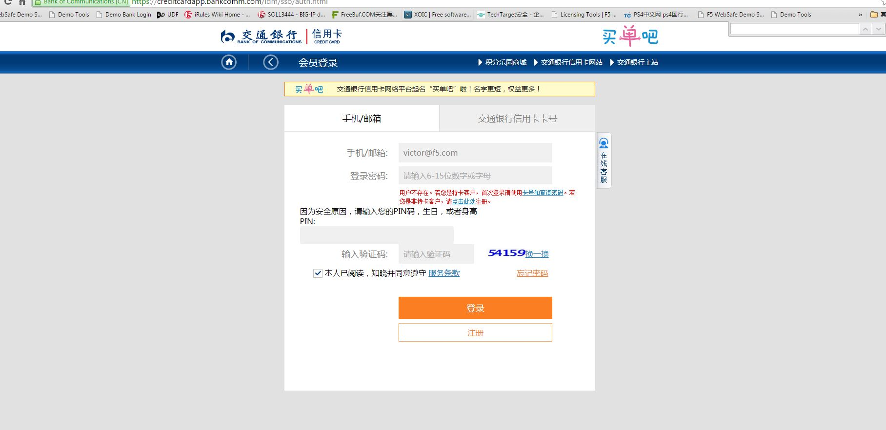
恶意软件探测服务- Generic Malware
可以直接恶意插入输入框，获取私人信息
Notes:
Malware detection: the ability to detect malware that is running on an end-point.
Advanced phishing detection: WebSafe can detect when a hacker takes content from our customer’s web page, manipulate it as necessary to make it appear exactly like the real page, it gets uploaded to a spoofed domain, such as www.amaz0n.com, and then they attempt to lure customers to the spoofed site. WebSafe can also capture user names of victims of phishing attacks. The F5 SOC can also take down phishing domain sites.
Application layer encryption: this is a protection mechanism. It enables the customer to encrypt data on the end-point while the data is being typed into an input field. For example on a login page with username and password fields, WebSafe can have the user’s password encrypted as they type each keyboard character in real-time. This makes it impossible for malware to capture the user’s password.
Automated transaction detection: because WebSafe is JavaScript based, our solution delivers obfuscated JavaScript code to the end-point. That code then looks for things like mouse movements and clicks, keyboard impressions, and time spent filling in a form. This creates a risk level that identifies the likelihood that this was performed by malware.
When any of these components issues an alert, F5 encourages the use of our security operation center (SOC).

Slide 39
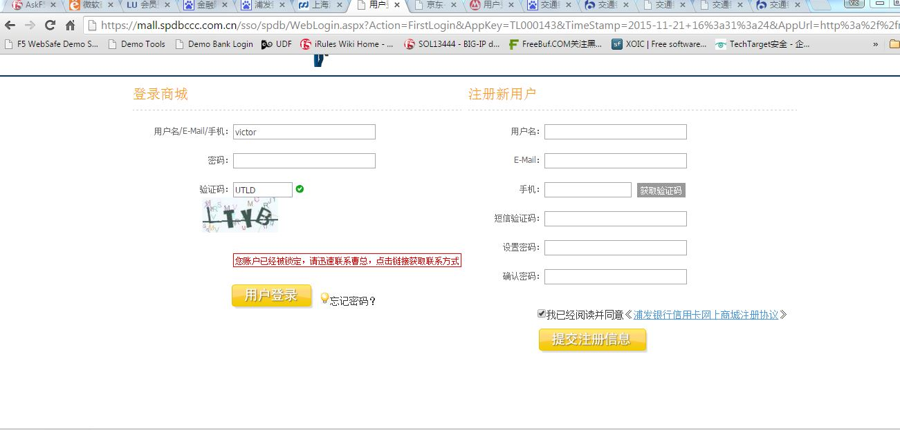
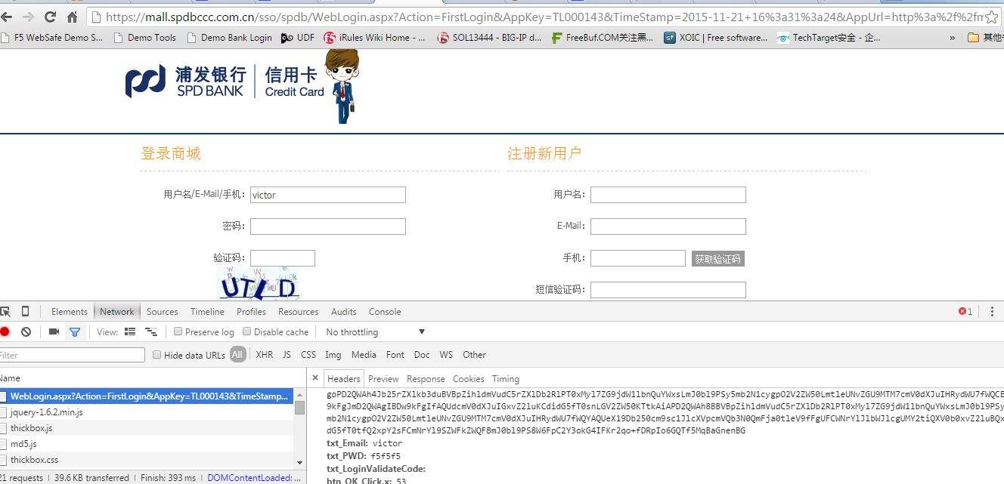
恶意软件探测服务-Generic Malware
被恶意修改了，点击链接，很可能指向的就是钓鱼网站了
又或者指向的是一个看似正常站点（Hacked），诱导下载一个JS，从而形成URL Injection
看见密码和用户
Notes:
Malware detection: the ability to detect malware that is running on an end-point.
Advanced phishing detection: WebSafe can detect when a hacker takes content from our customer’s web page, manipulate it as necessary to make it appear exactly like the real page, it gets uploaded to a spoofed domain, such as www.amaz0n.com, and then they attempt to lure customers to the spoofed site. WebSafe can also capture user names of victims of phishing attacks. The F5 SOC can also take down phishing domain sites.
Application layer encryption: this is a protection mechanism. It enables the customer to encrypt data on the end-point while the data is being typed into an input field. For example on a login page with username and password fields, WebSafe can have the user’s password encrypted as they type each keyboard character in real-time. This makes it impossible for malware to capture the user’s password.
Automated transaction detection: because WebSafe is JavaScript based, our solution delivers obfuscated JavaScript code to the end-point. That code then looks for things like mouse movements and clicks, keyboard impressions, and time spent filling in a form. This creates a risk level that identifies the likelihood that this was performed by malware.
When any of these components issues an alert, F5 encourages the use of our security operation center (SOC).

Slide 40


恶意软件探测服务-HTML Integrity
恶意的链接
这个是恶意添加的信用卡关联界面，直接就可以获取所有信息了
Notes:
Malware detection: the ability to detect malware that is running on an end-point.
Advanced phishing detection: WebSafe can detect when a hacker takes content from our customer’s web page, manipulate it as necessary to make it appear exactly like the real page, it gets uploaded to a spoofed domain, such as www.amaz0n.com, and then they attempt to lure customers to the spoofed site. WebSafe can also capture user names of victims of phishing attacks. The F5 SOC can also take down phishing domain sites.
Application layer encryption: this is a protection mechanism. It enables the customer to encrypt data on the end-point while the data is being typed into an input field. For example on a login page with username and password fields, WebSafe can have the user’s password encrypted as they type each keyboard character in real-time. This makes it impossible for malware to capture the user’s password.
Automated transaction detection: because WebSafe is JavaScript based, our solution delivers obfuscated JavaScript code to the end-point. That code then looks for things like mouse movements and clicks, keyboard impressions, and time spent filling in a form. This creates a risk level that identifies the likelihood that this was performed by malware.
When any of these components issues an alert, F5 encourages the use of our security operation center (SOC).

Slide 41

高级钓鱼网站探测服务
Advanced Phishing Detection
Notes:
Malware detection: the ability to detect malware that is running on an end-point.
Advanced phishing detection: WebSafe can detect when a hacker takes content from our customer’s web page, manipulate it as necessary to make it appear exactly like the real page, it gets uploaded to a spoofed domain, such as www.amaz0n.com, and then they attempt to lure customers to the spoofed site. WebSafe can also capture user names of victims of phishing attacks. The F5 SOC can also take down phishing domain sites.
Application layer encryption: this is a protection mechanism. It enables the customer to encrypt data on the end-point while the data is being typed into an input field. For example on a login page with username and password fields, WebSafe can have the user’s password encrypted as they type each keyboard character in real-time. This makes it impossible for malware to capture the user’s password.
Automated transaction detection: because WebSafe is JavaScript based, our solution delivers obfuscated JavaScript code to the end-point. That code then looks for things like mouse movements and clicks, keyboard impressions, and time spent filling in a form. This creates a risk level that identifies the likelihood that this was performed by malware.
When any of these components issues an alert, F5 encourages the use of our security operation center (SOC).

Slide 42


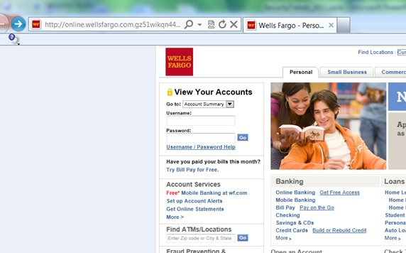
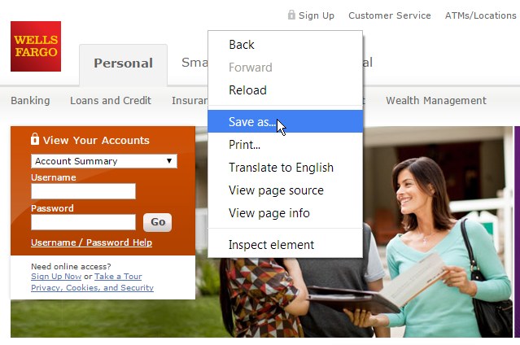
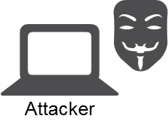
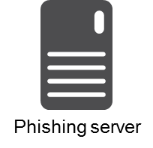
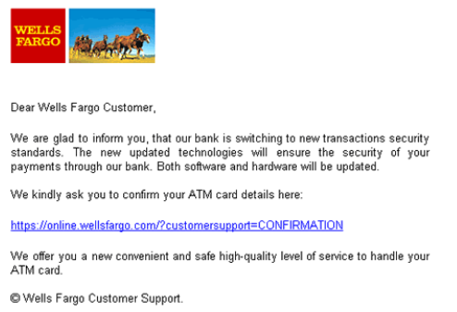
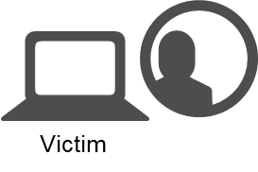
钓鱼网站的工作机制
Phishing server
Wells Fargo
C&C
Drop Zone
The attacker saves a copy of the web pages to their own web server
The victim provides confidential data directly to the hacker
极短的存在时间
连环钓鱼
相似域名
反钓鱼网站联盟
事后处理
The attacker access the real web page
The attacker sends a phishing request to many victims
The victim visits what they think is a legitimate site but is actually the phishing site

Slide 43




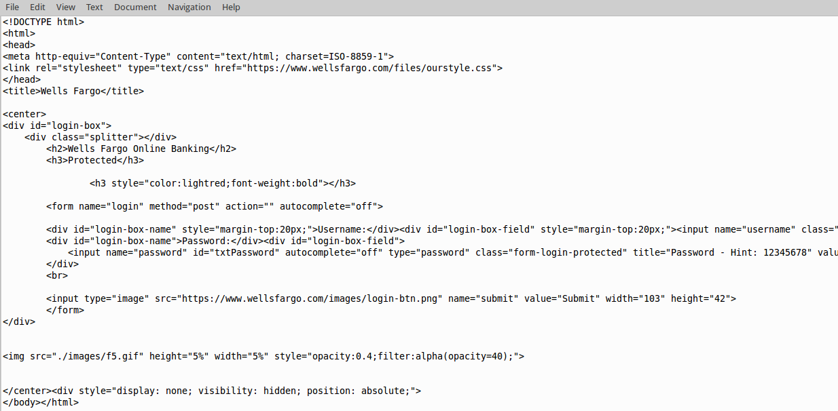
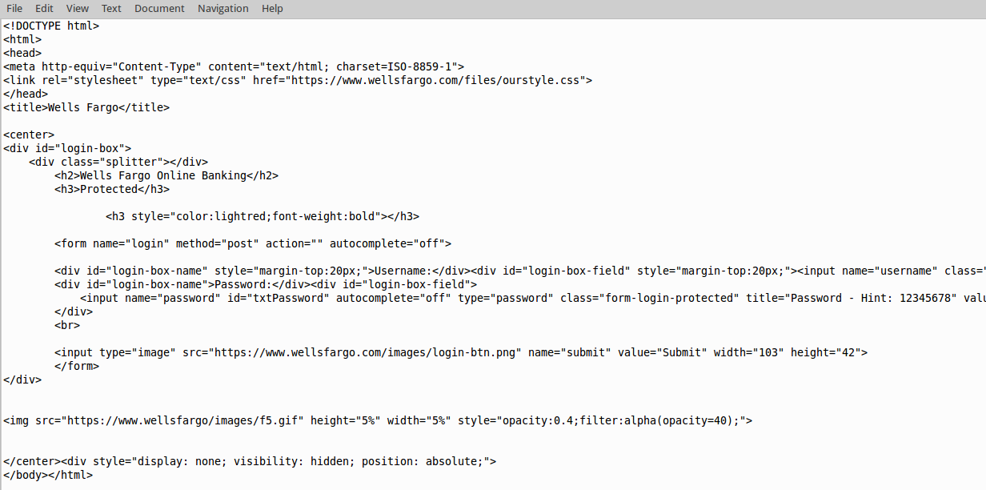
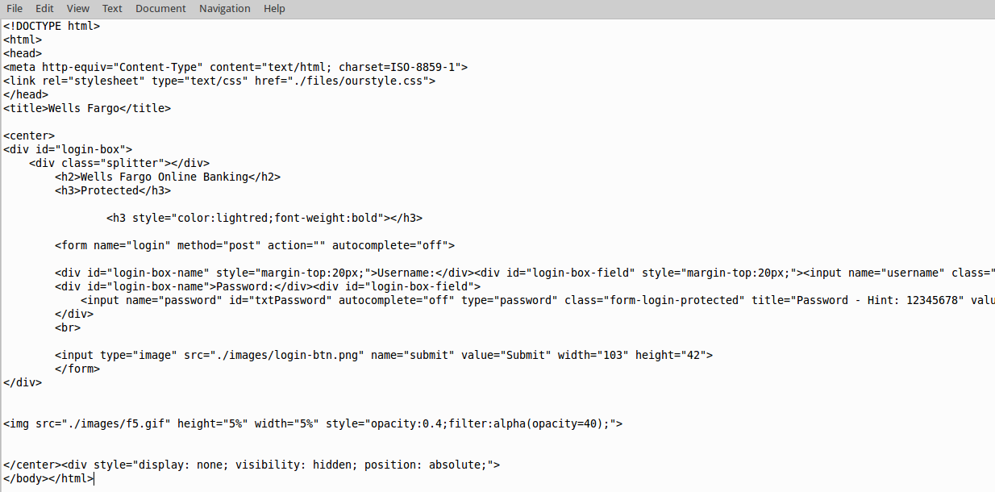
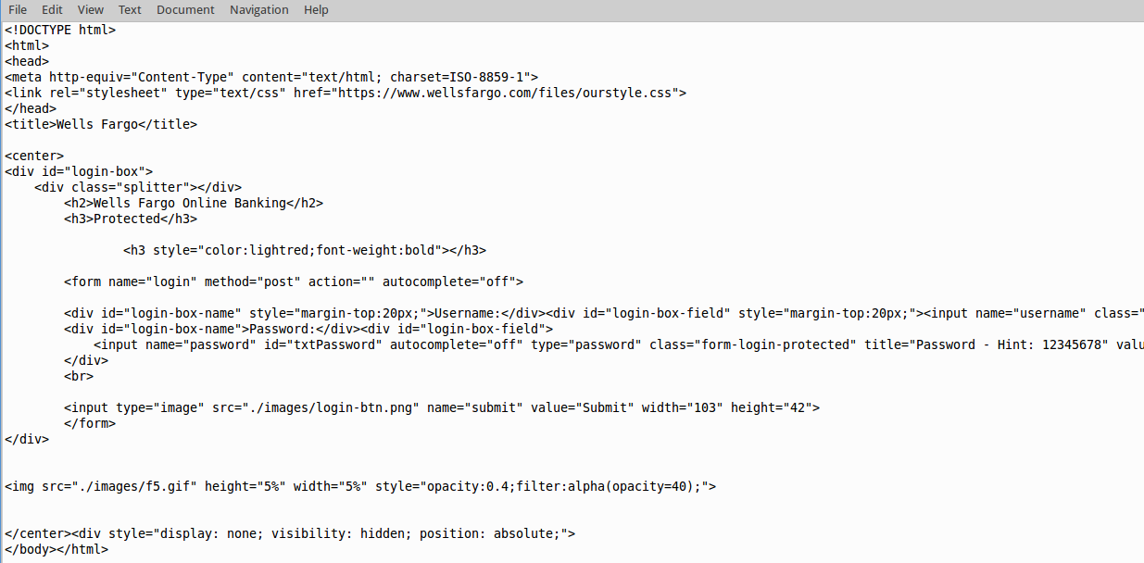



高级钓鱼网站探测服务-- referenced resources
Sometimes a hacker will build a phishing page from scratch
Data center
Web application
Instead of saving all objects locally, the hacker may reference some objects from the legitimate site
Phishing server
Attacker
A victim accesses the phishing web site
This eliminates substantial bandwidth for the hacker for stylesheets and image files
LTM
Victim
LTM + FPS
The page request comes from the phishing server
Other referenced objects come from the legitimate web site
Notes:
If a hacker decides to build a phishing site from scratch and decides to reference files from the legitimate site to save bandwidth.
Referrer checks are not cached. Valid reference referrers can be added to the global whitelist in the FPS profile.
Note, this is one of the instances where the BIG-IP system initiates the alert, not the client’s browser.

Slide 44
应用层加密服务
Application Layer Encryption
Notes:
Malware detection: the ability to detect malware that is running on an end-point.
Advanced phishing detection: WebSafe can detect when a hacker takes content from our customer’s web page, manipulate it as necessary to make it appear exactly like the real page, it gets uploaded to a spoofed domain, such as www.amaz0n.com, and then they attempt to lure customers to the spoofed site. WebSafe can also capture user names of victims of phishing attacks. The F5 SOC can also take down phishing domain sites.
Application layer encryption: this is a protection mechanism. It enables the customer to encrypt data on the end-point while the data is being typed into an input field. For example on a login page with username and password fields, WebSafe can have the user’s password encrypted as they type each keyboard character in real-time. This makes it impossible for malware to capture the user’s password.
Automated transaction detection: because WebSafe is JavaScript based, our solution delivers obfuscated JavaScript code to the end-point. That code then looks for things like mouse movements and clicks, keyboard impressions, and time spent filling in a form. This creates a risk level that identifies the likelihood that this was performed by malware.
When any of these components issues an alert, F5 encourages the use of our security operation center (SOC).

Slide 45
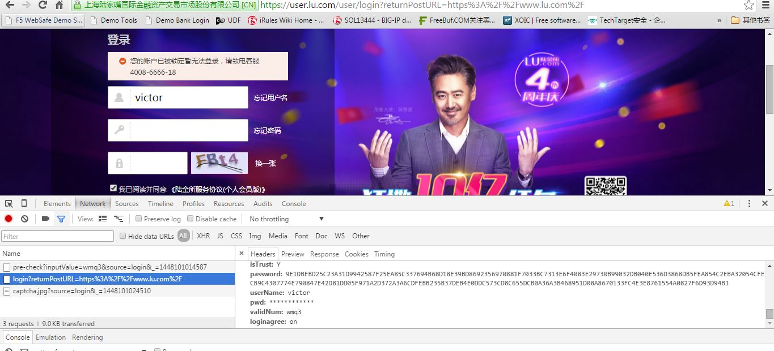
应用层加密服务
密码这个字段已经做了混淆加密，无法读取
Notes:
Malware detection: the ability to detect malware that is running on an end-point.
Advanced phishing detection: WebSafe can detect when a hacker takes content from our customer’s web page, manipulate it as necessary to make it appear exactly like the real page, it gets uploaded to a spoofed domain, such as www.amaz0n.com, and then they attempt to lure customers to the spoofed site. WebSafe can also capture user names of victims of phishing attacks. The F5 SOC can also take down phishing domain sites.
Application layer encryption: this is a protection mechanism. It enables the customer to encrypt data on the end-point while the data is being typed into an input field. For example on a login page with username and password fields, WebSafe can have the user’s password encrypted as they type each keyboard character in real-time. This makes it impossible for malware to capture the user’s password.
Automated transaction detection: because WebSafe is JavaScript based, our solution delivers obfuscated JavaScript code to the end-point. That code then looks for things like mouse movements and clicks, keyboard impressions, and time spent filling in a form. This creates a risk level that identifies the likelihood that this was performed by malware.
When any of these components issues an alert, F5 encourages the use of our security operation center (SOC).

Slide 46

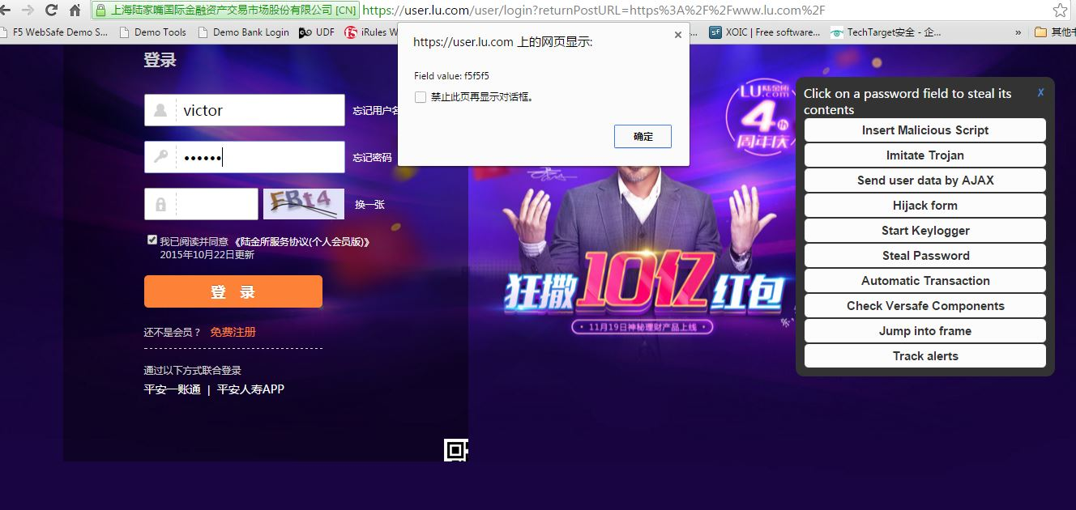

应用层加密服务
密码已经到手了
Notes:
Malware detection: the ability to detect malware that is running on an end-point.
Advanced phishing detection: WebSafe can detect when a hacker takes content from our customer’s web page, manipulate it as necessary to make it appear exactly like the real page, it gets uploaded to a spoofed domain, such as www.amaz0n.com, and then they attempt to lure customers to the spoofed site. WebSafe can also capture user names of victims of phishing attacks. The F5 SOC can also take down phishing domain sites.
Application layer encryption: this is a protection mechanism. It enables the customer to encrypt data on the end-point while the data is being typed into an input field. For example on a login page with username and password fields, WebSafe can have the user’s password encrypted as they type each keyboard character in real-time. This makes it impossible for malware to capture the user’s password.
Automated transaction detection: because WebSafe is JavaScript based, our solution delivers obfuscated JavaScript code to the end-point. That code then looks for things like mouse movements and clicks, keyboard impressions, and time spent filling in a form. This creates a risk level that identifies the likelihood that this was performed by malware.
When any of these components issues an alert, F5 encourages the use of our security operation center (SOC).

Slide 47
自动交易探测服务
Automatic Transaction Detection
Notes:
Malware detection: the ability to detect malware that is running on an end-point.
Advanced phishing detection: WebSafe can detect when a hacker takes content from our customer’s web page, manipulate it as necessary to make it appear exactly like the real page, it gets uploaded to a spoofed domain, such as www.amaz0n.com, and then they attempt to lure customers to the spoofed site. WebSafe can also capture user names of victims of phishing attacks. The F5 SOC can also take down phishing domain sites.
Application layer encryption: this is a protection mechanism. It enables the customer to encrypt data on the end-point while the data is being typed into an input field. For example on a login page with username and password fields, WebSafe can have the user’s password encrypted as they type each keyboard character in real-time. This makes it impossible for malware to capture the user’s password.
Automated transaction detection: because WebSafe is JavaScript based, our solution delivers obfuscated JavaScript code to the end-point. That code then looks for things like mouse movements and clicks, keyboard impressions, and time spent filling in a form. This creates a risk level that identifies the likelihood that this was performed by malware.
When any of these components issues an alert, F5 encourages the use of our security operation center (SOC).

Slide 48
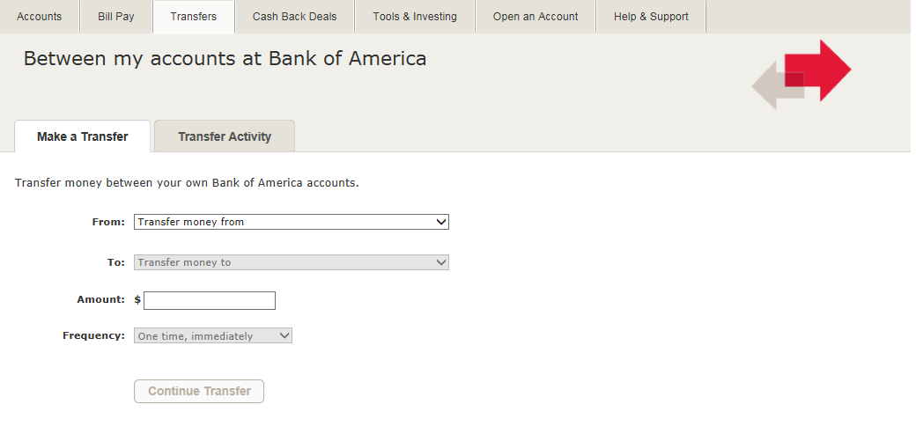
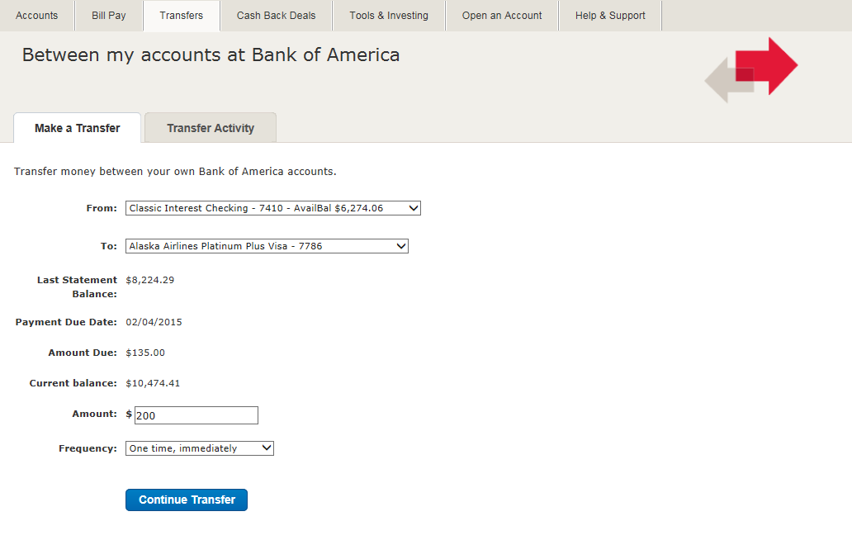
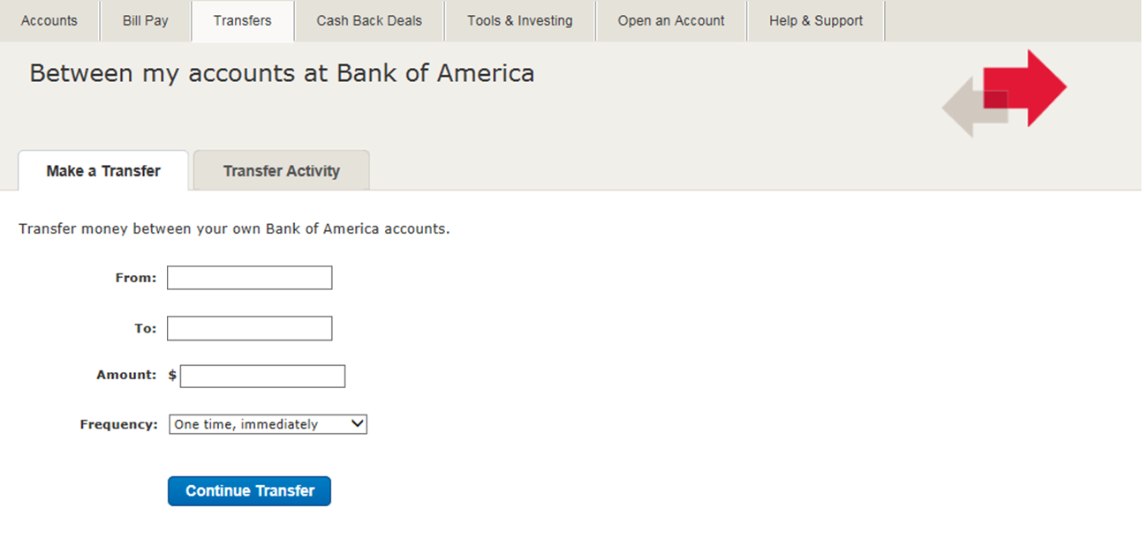


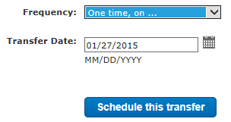
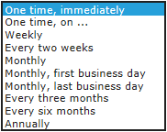

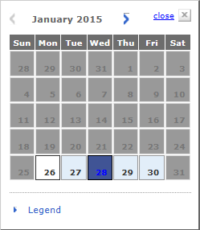
自动交易探测服务- Automatic Transactions Online
To complete this form, how many mouse movements are expected, and how long should it take?
整个交易过程中，鼠标移动了16次，时间共计25秒
F5中可建议设置鼠标移动次数10次，时间设置20秒,低于这个值就告警。
2
1
Page read time:
87334234
3
For an average user it takes approximately 25 seconds to complete and submit this form
4
5
23113489-88
6
10
14
15
18
21
23
25
25
11
0
5
3
7
7
9
2500.00
8
11
10
12
16
15
13
For an average user it takes about 16 mouse movements to complete and submit this form
14

Slide 49
我并不特别聪明，只是在问题上坚持的时间比较长罢了。
It‘s not that I’m so smart, it‘s just that I stay with problems longer.
- 阿尔伯特.爱因斯坦 Albert Einstein

